Slide 2
Today’s Agenda
2014 Marketing Plan
  Share Approach to 2014 Planning
How to Connect
  The new VisitMaine.com
  Packaging & Itinerary Development
Partner Resources

Slide 4
CONSUMER TRENDS
Notes:
To understand our annual plan, it helps to look at broader consumer travel trends.

Slide 5
Key Consumer Trends
Consumer trends indicate that tomorrow’s visitors are all about self-benefits
They will want:
  Special interest experiences--traveling with/for a purpose
  Interactive learning experiences
  Authentic, unique experiences
  Physical or psychological challenges
  Customized/individualized travel that matches one’s personal identity and values
Notes:
For today’s consumer, travel is a big deal—in their perfect world, authentic and adventurous travel creates new connections and friends, it refreshes existing relationships, and it sets the groundwork for personal transformation
Starting in 2012, MOT built its marketing upon a values-based approach—the “sweet spot” between what Maine offers, what visitors/prospects want, and what is unique about the Maine experience
The good news is that tomorrow’s visitors are even more about self-benefits—benefits that entice them to come to Maine, enrich their self-identities, and enhance who they want to become.
They want:
Experiences that reflect travel with/for a purpose
Interactive learning experiences (different cultures, personal enrichment, hands-on)
Authentic, unique experiences (with the experience mattering more than the destination per se)
Physical or psychological challenges (particularly nature/culture)
Customized, individualized travel that matches one’s personal identity and values

Slide 6
CREATE BRAND CRAVING
Notes:
Knowing this, Maine wants to create brand craving.

Slide 7
MAINE’S BRAND PARADIGM
Notes:
We do this by taking all of Maine’s icons like:
Lobsters
Lighthouses
Moose
Our Diversity
Variety
Hidden gems and unexpected experiences yet to be discovered.
Add to that the traveler’s mindset and brand perceptions, such as:
Self-reliance
Pragmatism
Sustainability
Quirky
And genuine
Then combine it with the traveler’s originality, personal values and contemporary cravings to get Maine’s differentiated brand benefit.
A place where you can follow your inner compass and be completely yourself.

Slide 8
KEY
GOALS
Notes:
This brings us to our key goals.

Slide 9
Continue to build & create brand awareness
Place additional emphasis on driving first time visitors
Create more opportunities for direct engagement with the brand
    Content distribution
    Partnerships
    Promos/sweepstakes

Slide 10
THE REAL THING.
FROM REAL PEOPLE.
GIVING REAL ADVICE.
Notes:
This brings us to our campaign
The Real Thing
From Real People
Giving Real Advice

Slide 11

Notes:
It’s what we call The Maine Thing.

Slide 12
STORY
TELLING
Notes:
And it’s about story telling.
Stories capture the essence of Maine’s original, offbeat, one-of-a-kind, quirky and pragmatic character.

Slide 13
  Storytellers can be:
    Insiders
    Visitors
    Bloggers
    Multi-media editorial features
    Publishers & partnerships

Slide 14
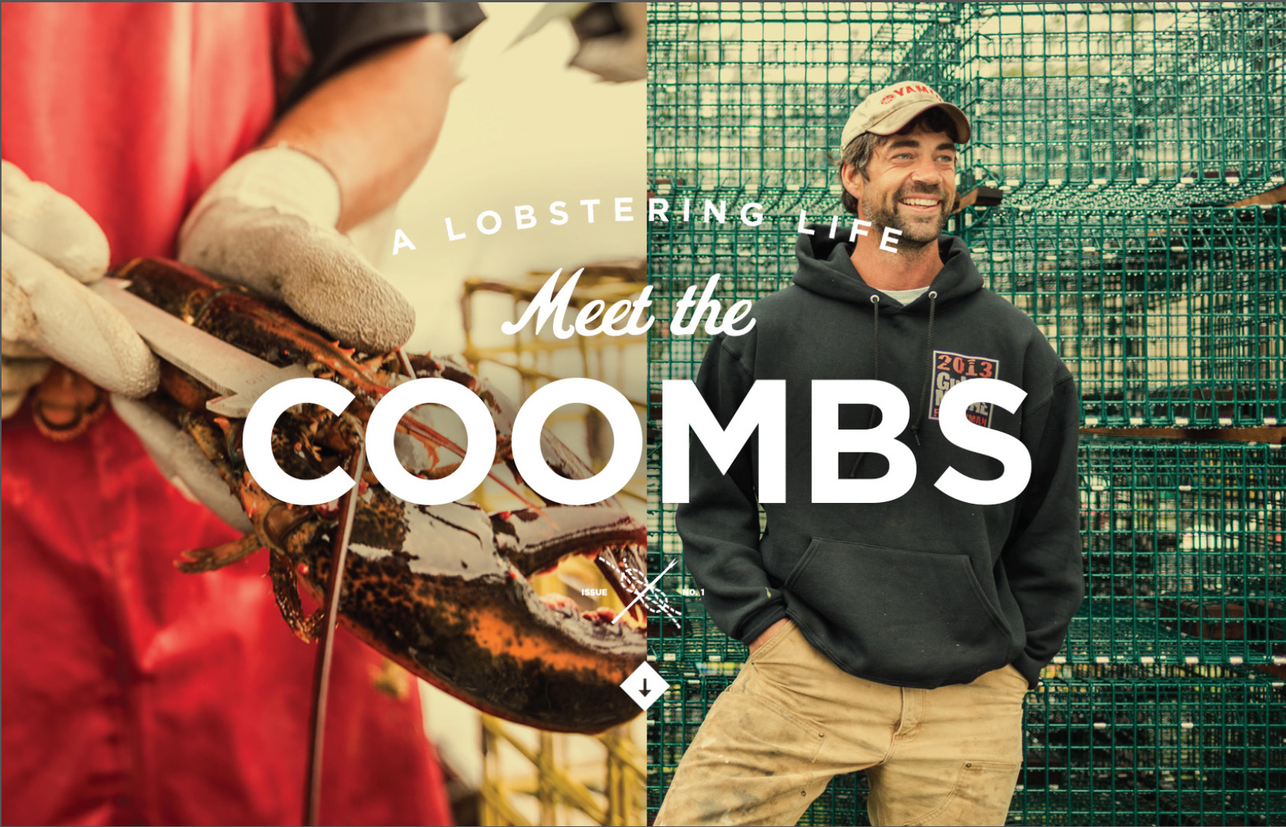
Maine Insiders
Notes:
Our Insiders are real Mainers who share their personal stories, tips and local secrets with visitors (ok, maybe not too many local secrets).

Slide 15

Notes:
Here’s a sampling of storytelling through our latest Insider’s video.

Slide 17
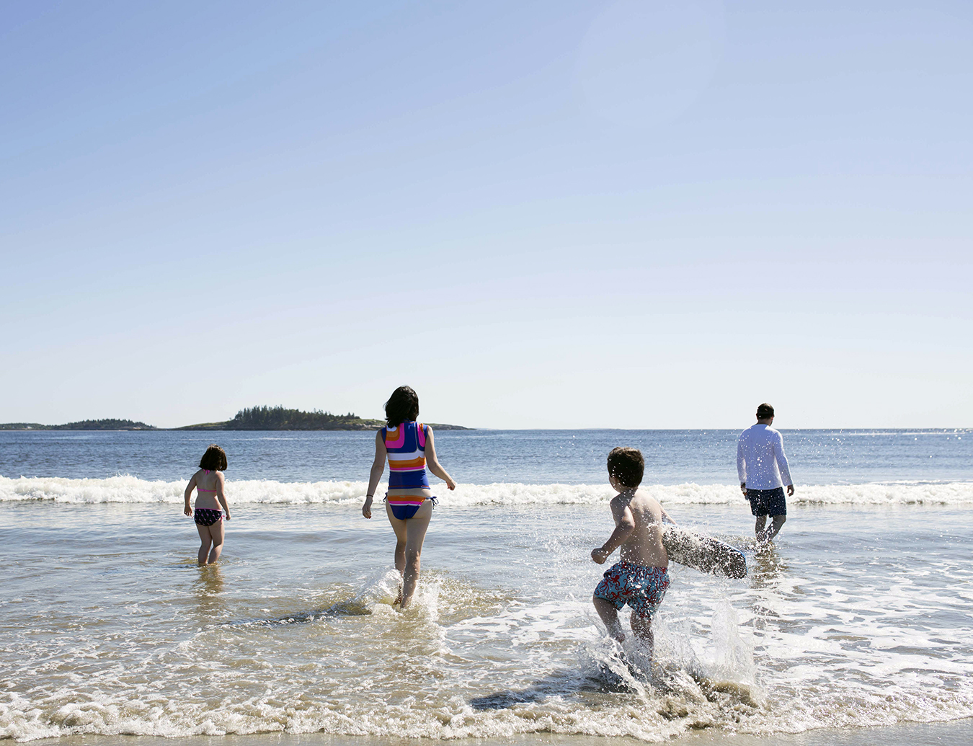
Notes:
Another recent addition to the Insider’s program is the Hazard Family.

Slide 18
Notes:
Jennifer Hazard’s family explores the state looking for family fun – and writers about it on our web site and her own blog.

Slide 19
Notes:
In addition to advertising in print and online, we are creating other ways to entice people to Maine.

Slide 20
FEATURED
E-ZINES
Notes:
First, is our new e-Zine.

Slide 21
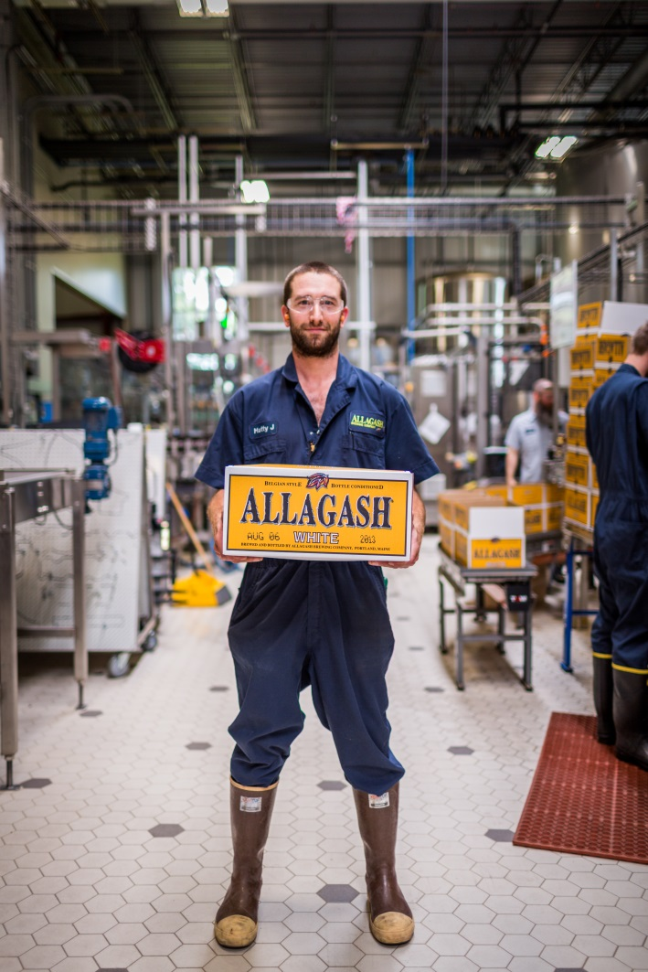
Feature E-Zine
Quarterly in-depth editorial – magazine style - features on VisitMaine.com that are multi-media in nature
    Lobster Culture
    Beer Trail/Craft Beer
    Leaf-peeping
    Thoreau Wabanaki Trail

Slide 22
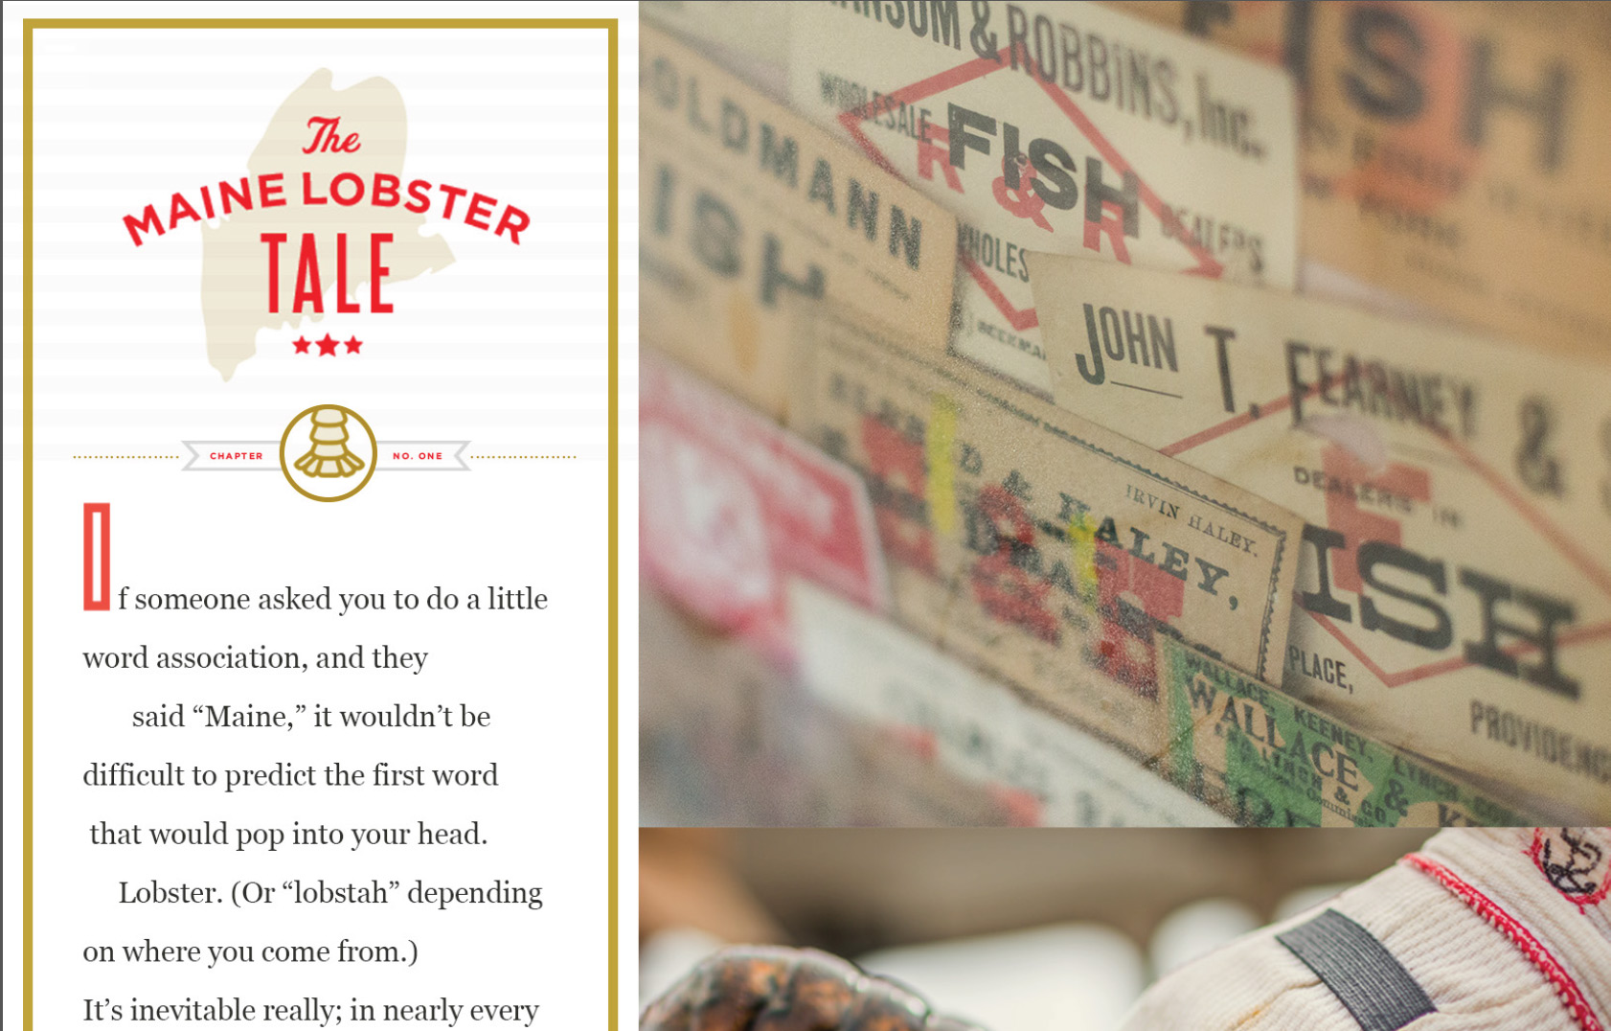
The Maine Lobster Tale
Notes:
Our first e-zine has 4 chapters about lobstering.
Embedded within it are videos that are designed to be easily shared through social media channels.

Slide 23
Testing Television
A great way to communicate the emotional “heart” of
the brand
Combination of network & cable allows for “brand awareness” plus “direct response”
  Network Spot Market buy - Albany, NY and Hartford, CT
  National Cable on AT&T U Verse allows for Travel Planner requests
Leverage existing video assets built up over the last two years
Notes:
We’ll be testing a television campaign.
This campaign is twofold:
Spot television in the Albany and Hartford markets.
And National Cable through the AT&T U-Verse for travel planner requests.

Slide 24
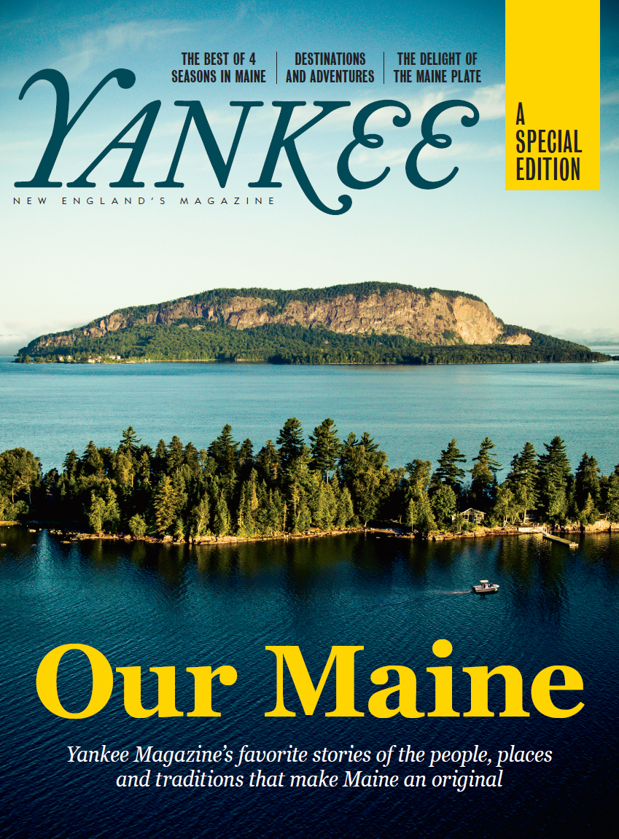



Third Party Content
Notes:
We have strategic partnerships to provide third party content.
Our first was with Yankee Magazine, New England’s premiere lifestyle publication.
Others include Saveur – Sponsorship. Maine features, banner ads.
Travel Squire – online travel resource site. Featured stories and email messages.
Sharethrough – A native advertising campaign (Places Maine stories and video into the look and feel of the sites they are being place on). Kind of a modern day advertorial.

Slide 25
CUSTOMER
ENGAGEMENT

Slide 26
Sweepstakes Drive Engagement
  Tell us your Maine Thing and be registered to win…
  Cross promote opt-ins and planning materials
  Must be brand compatible
    Win a trip to design or build something of your own that is distinctly Maine. Do something original with your hands
Notes:
Get people to tell us their Maine Thing.
To hear in consumers own words, what intrigues them or attracts them to Maine.

Slide 27
Notes:
The center-piece of our campaign is the new visitmaine.com web site.
So I wanted to take a few minutes to go through some of the new features.

Slide 28
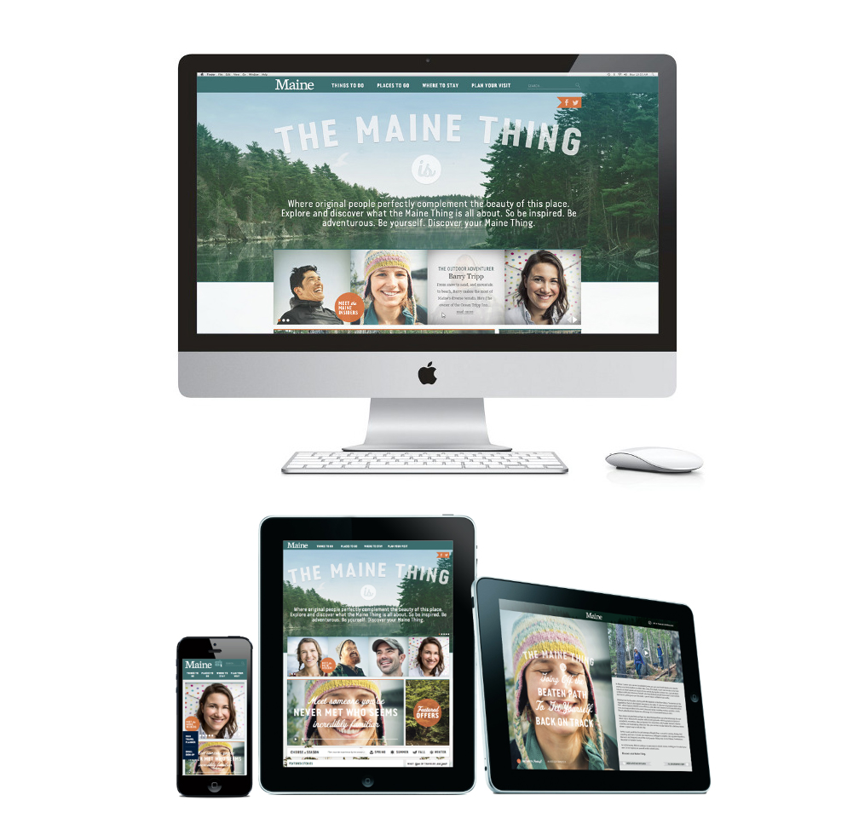
Notes:
Responsive

Slide 29
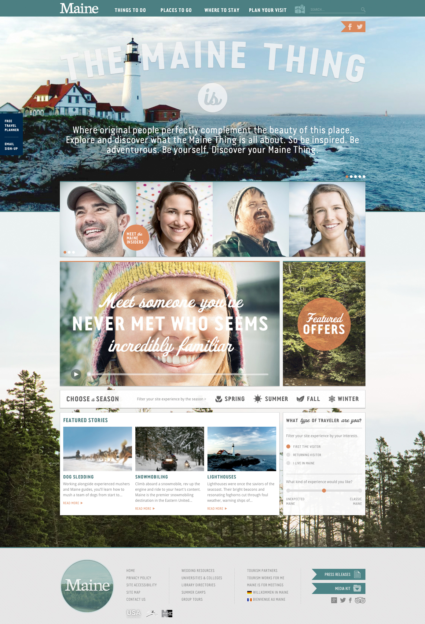
Notes:
The Insiders figure prominently into the design.

Slide 30
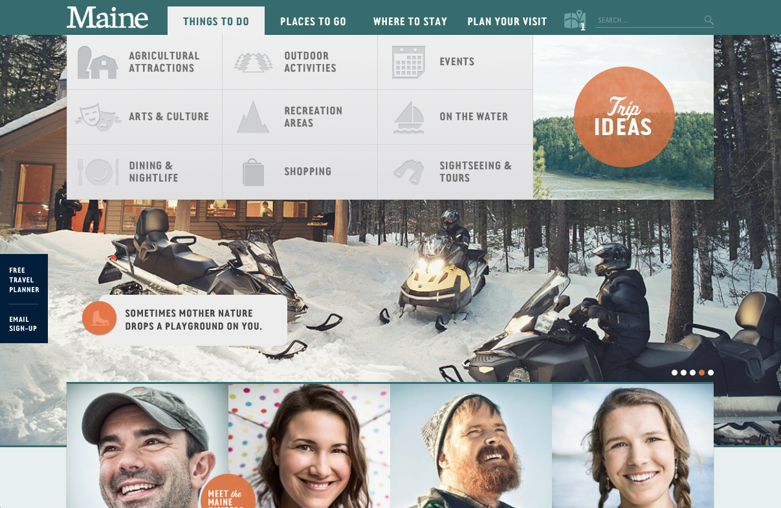
Notes:
Simplified navigation

Slide 31
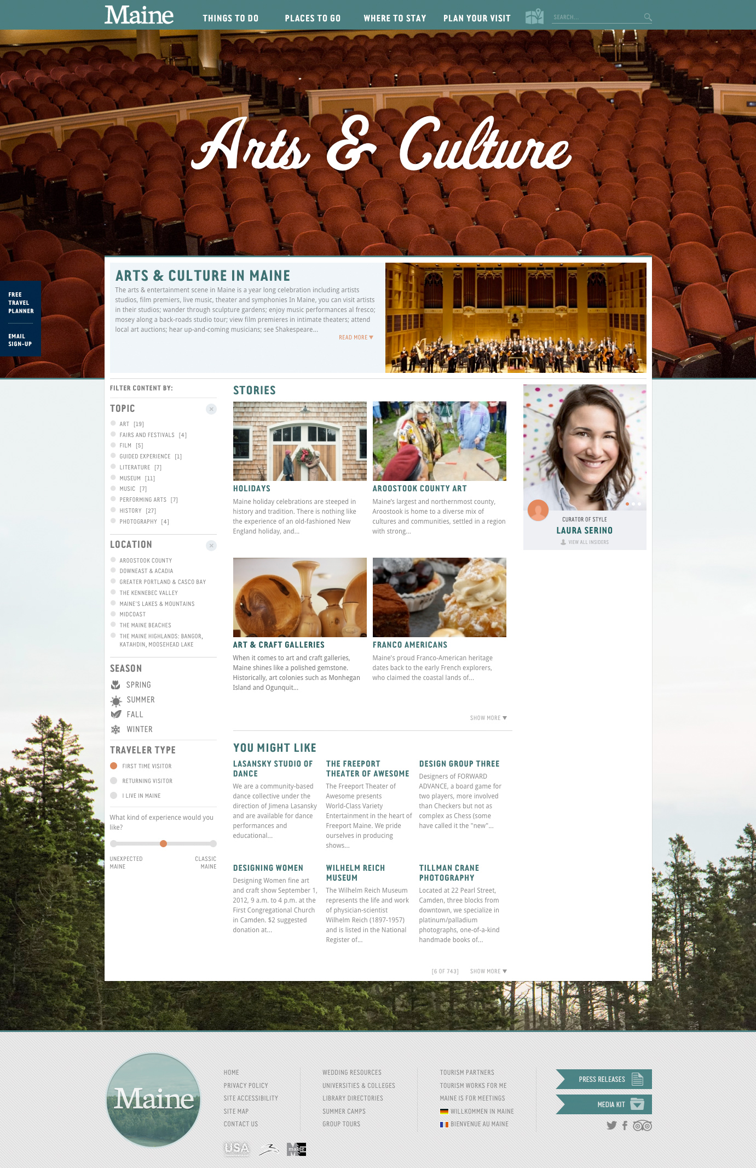
Notes:
A more magazine style layout with stories and business listings related to the stories.

Slide 32
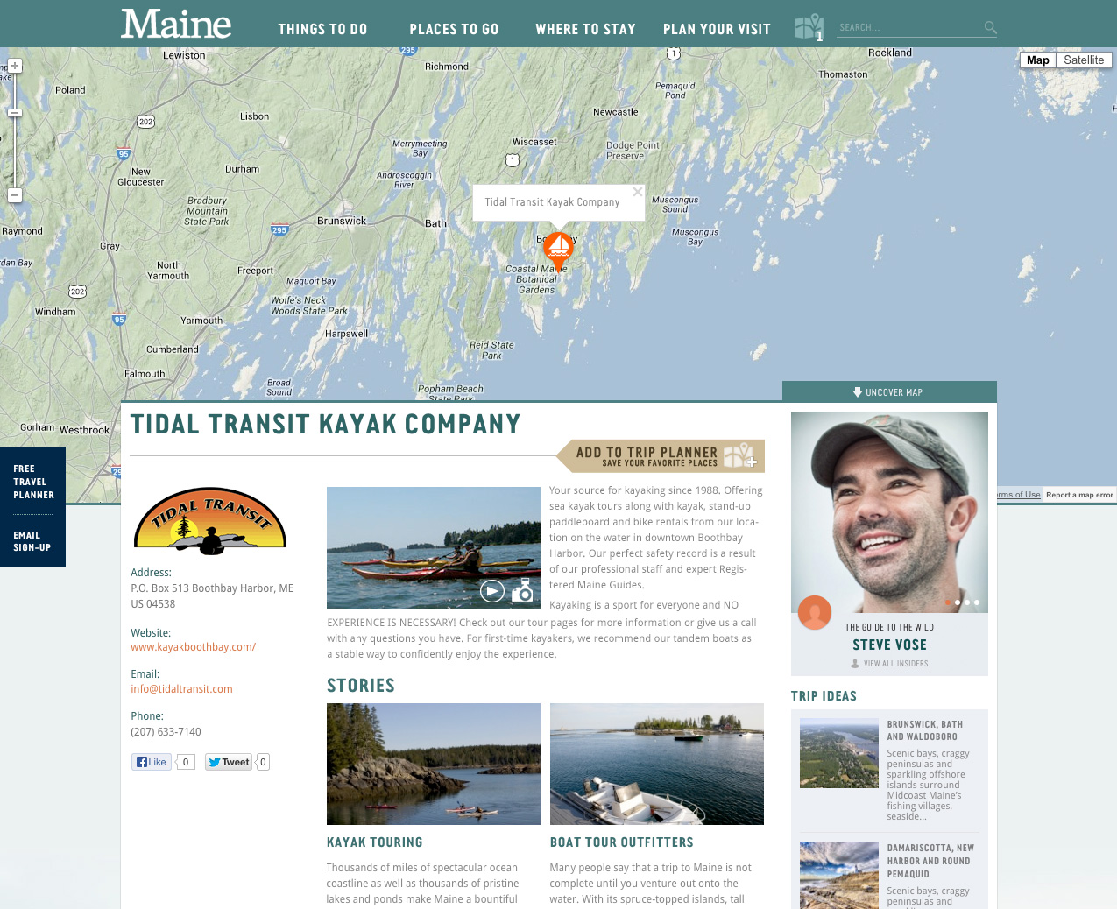
Notes:
New mapping capability that allows for single point or multi-point mapping.
Listings that allow for your logo, photos or video to be included.

Slide 33
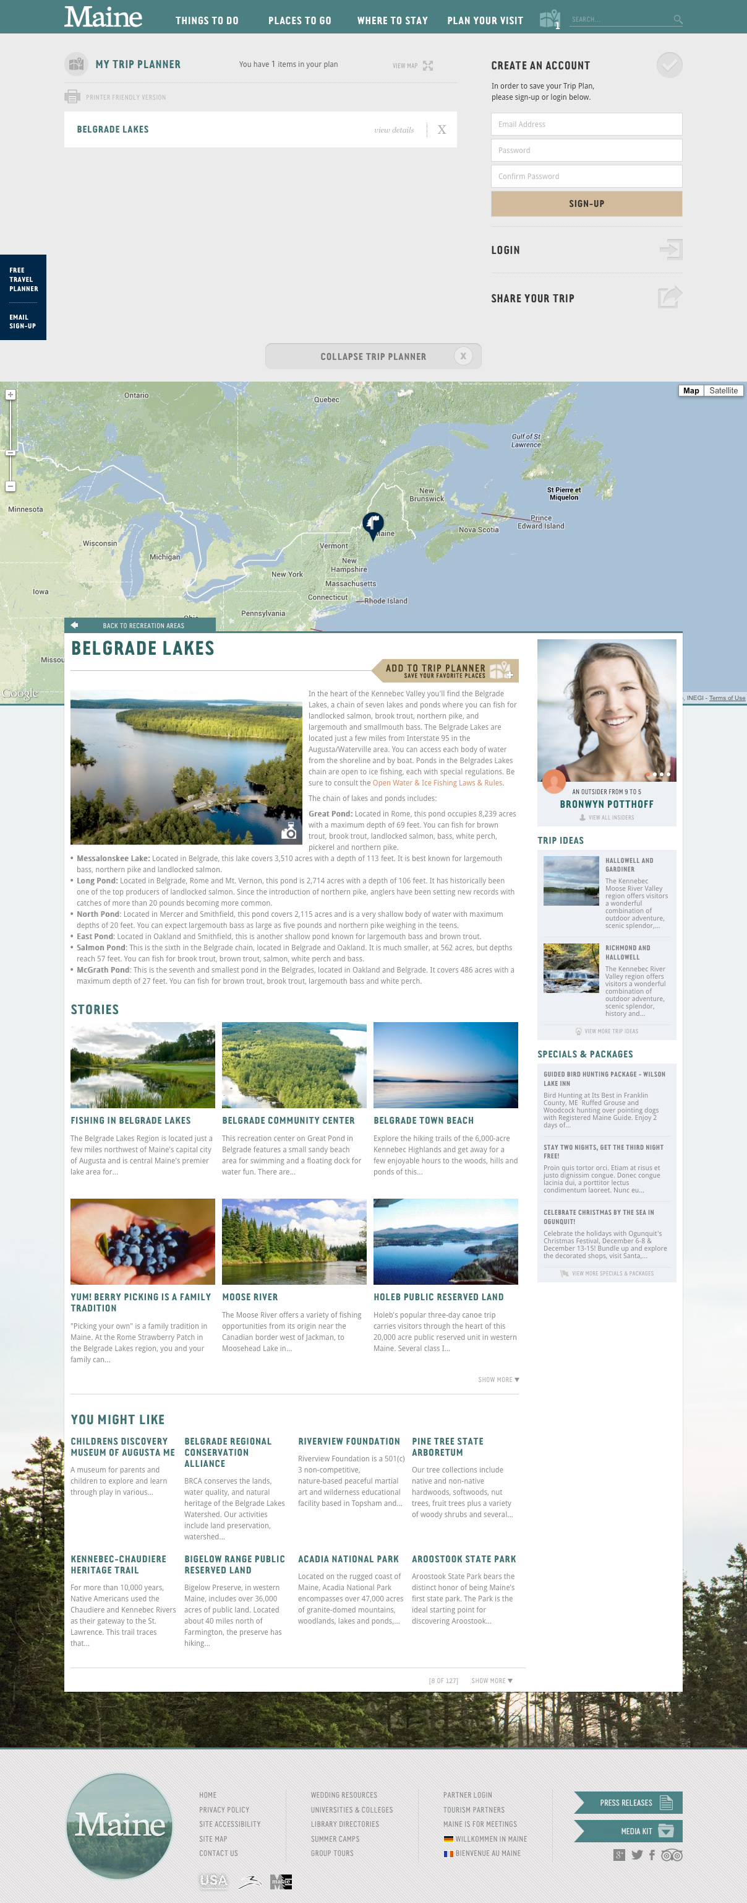
Notes:
An easy-to-use trip planner that enables people to select stories and listings to plan their trip.

Slide 34
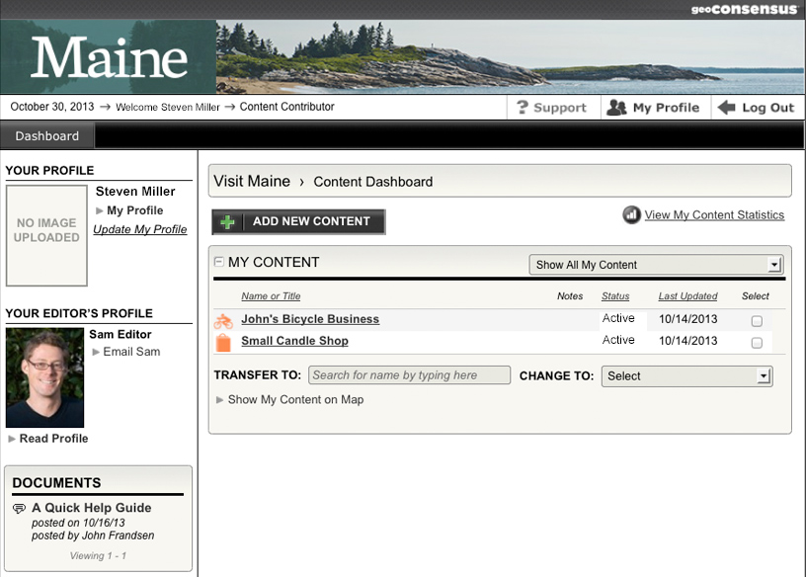
Notes:
A redesigned back end to help you better manage your listing.

Slide 35
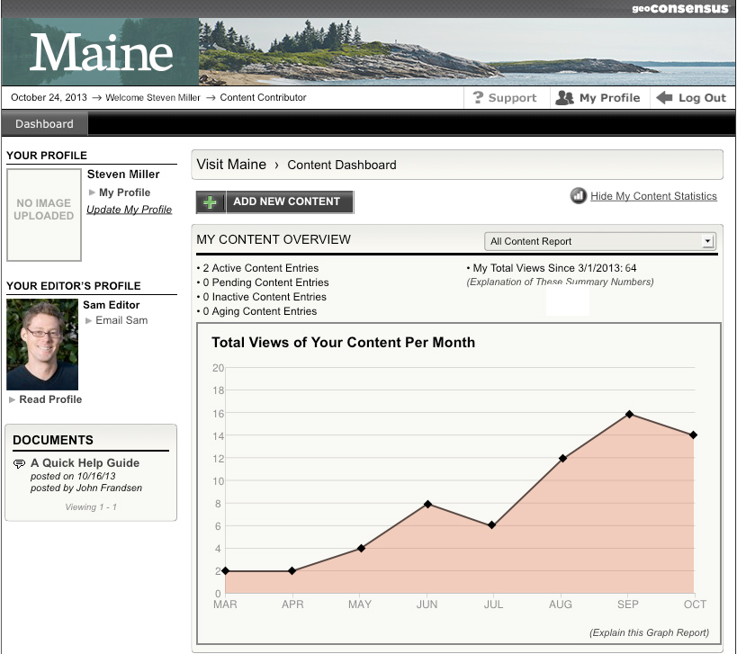
Notes:
Finally, some basic analytics to see how many views your content is receiving.

Slide 36
INDUSTRY OUTREACH
Rolling e-mails to encourage businesses to update their listings and take advantage of new benefits
Video Tutorials
E-mail contact for hands on help

Slide 38
WHAT IS
PRODUCT DEVELOPMENT?

Slide 39
WHAT ARE YOUR BUSINESS GOALS?
Repeat visits
Increase length of stay
Promote shoulder season
Increase customer satisfaction
Increase profit margins
Produce new revenues

Slide 40
Key Consumer Trends
Quick review:
  Special interest experiences--traveling with/for a purpose
  Interactive learning experiences
  Authentic, unique experiences
  Customized/individualized travel that matches one’s personal identity and values
  And a few other considerations:
  Convenience
  Value; price is not always the key
  Online research
  Booking closer to departure date
  Trip length is 3-4 days

Slide 41
CREATE
ITINERARIES & PACKAGES

Slide 42
WHAT IS AN ITINERARY?
The suggested route a proposed trip may take
Notable points of interest along that route
Recommended timeline

Slide 43
WHAT IS PACKAGE?
Two or more vacation products combined and assigned one price
Recommendation: add something surprising, unexpected and sure to delight!

Slide 44
Sample Package
“On the Rocks” Package
  Includes 2 nights lodging
  Packed champagne picnic lunch
  Choice of sun-bathing on secluded private rock island or kayak trip along rocky shoreline
  Favorite cocktail “on the rocks” with complimentary hors d’oeuvres in rocking chairs on the front porch
  Evening swim just before bedtime – you’ll sleep like a rock!
  The Surprise: Present guest with photos as they leave to remind them of their special vacation!
Notes:
For today’s consumer, travel is a big deal—in their perfect world, authentic and adventurous travel creates new connections and friends, it refreshes existing relationships, and it sets the groundwork for personal transformation
Starting in 2012, MOT built its marketing upon a values-based approach—the “sweet spot” between what Maine offers, what visitors/prospects want, and what is unique about the Maine experience
The good news is that tomorrow’s visitors are even more about self-benefits—benefits that entice them to come to Maine, enrich their self-identities, and enhance who they want to become.
They want:
Experiences that reflect travel with/for a purpose
Interactive learning experiences (different cultures, personal enrichment, hands-on)
Authentic, unique experiences (with the experience mattering more than the destination per se)
Physical or psychological challenges (particularly nature/culture)
Customized, individualized travel that matches one’s personal identity and values

Slide 46
Seminars & Workshops
Itinerary Building & Packaging
Motorcoach 101
Nature-based Tourism Site Evaluation
How Tourism Works for You
How to Select & Work a Trade Show
How to Plan & Organize a Successful Event
New visitmaine.com 101

Slide 47
On MOTPartners.com
Study industry research
Access past MOT presentations
Link to Welcome ME
  FREE online customer service training

Slide 48
On MOTPartners.com
2013 Economic Impact & Highlights
5 Year Strategic Plan
2014 MOT Annual Marketing Plan
http://visitmaine.com/assets/downloads/secure/
UN=mot
PW=maine2014

Slide 49
Additional Resources
PR Partners Program
DECD Governor’s Account Executives
Discover New England Summit 2014
  Pre-scheduled one-on-one appointments with over 70 tour and receptive operators from 7 countries
  May 19-21, 2014 Mystic, CT

